Slide 1

Brazilian feelings about elections
(on twitter)
Ciência de dados - IMD0905
Professor Ivanovitch

Slide 2

Hello!
We are:
Paulo
Data collecting and processing
Hugo
Map plotting and data cleaning
Tyrone
Idealizer, research and documenting

Slide 3
1.
The great idea
What we want to do

Slide 4
Feeling analysis from twitter
Get a lot of tweets in a context
Analyze the content polarity
Plot it on a map divided by states

Slide 5
How to do this?
Which tools, libs we use

Slide 6
Python Libraries
TweePy
An easy-to-use Python library for accessing the Twitter API.
TextBlob
A Python library for processing textual data. It provides a simple API for into common natural language processing (NLP) tasks.
Folium and Shapely
Folium makes it easy to visualize data that’s been manipulated in Python on an interactive leaflet map.
Shapely is a BSD-licensed Python package for manipulation and analysis of planar geometric objects

Slide 7
Challenges?
Tweet doesn’t provides a nice geolocation
Google translate API rate limit
Choose the search key

Slide 8
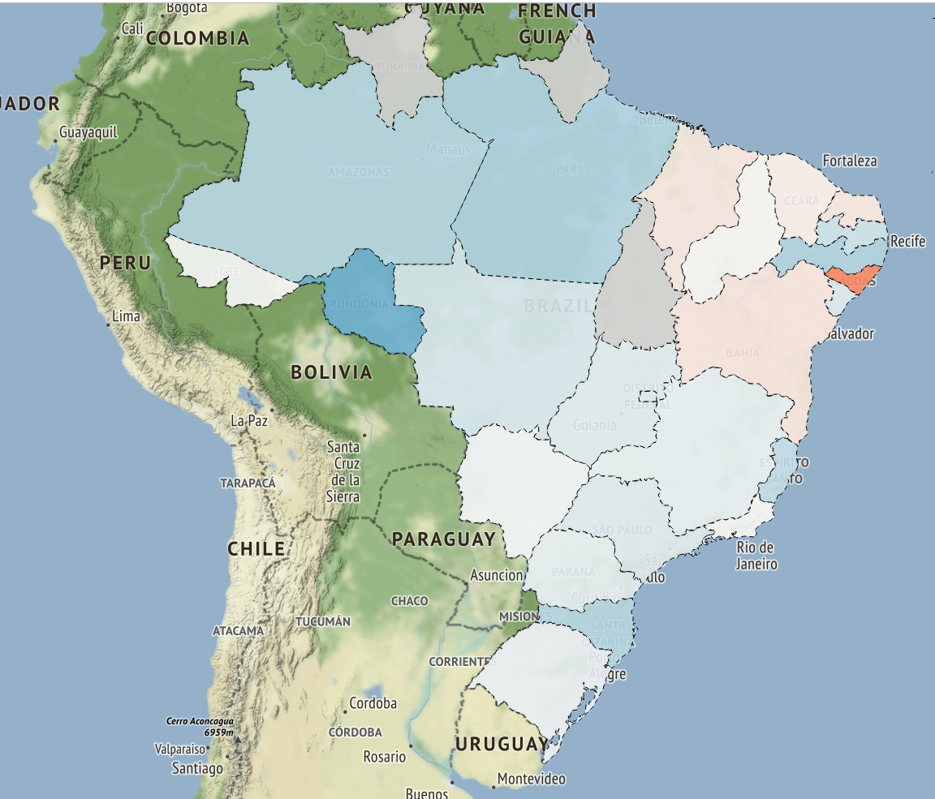
First Results

Slide 9
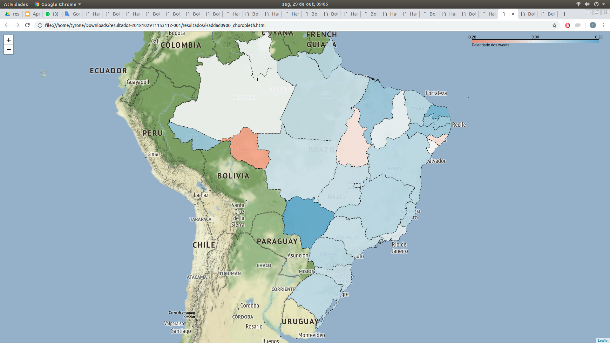
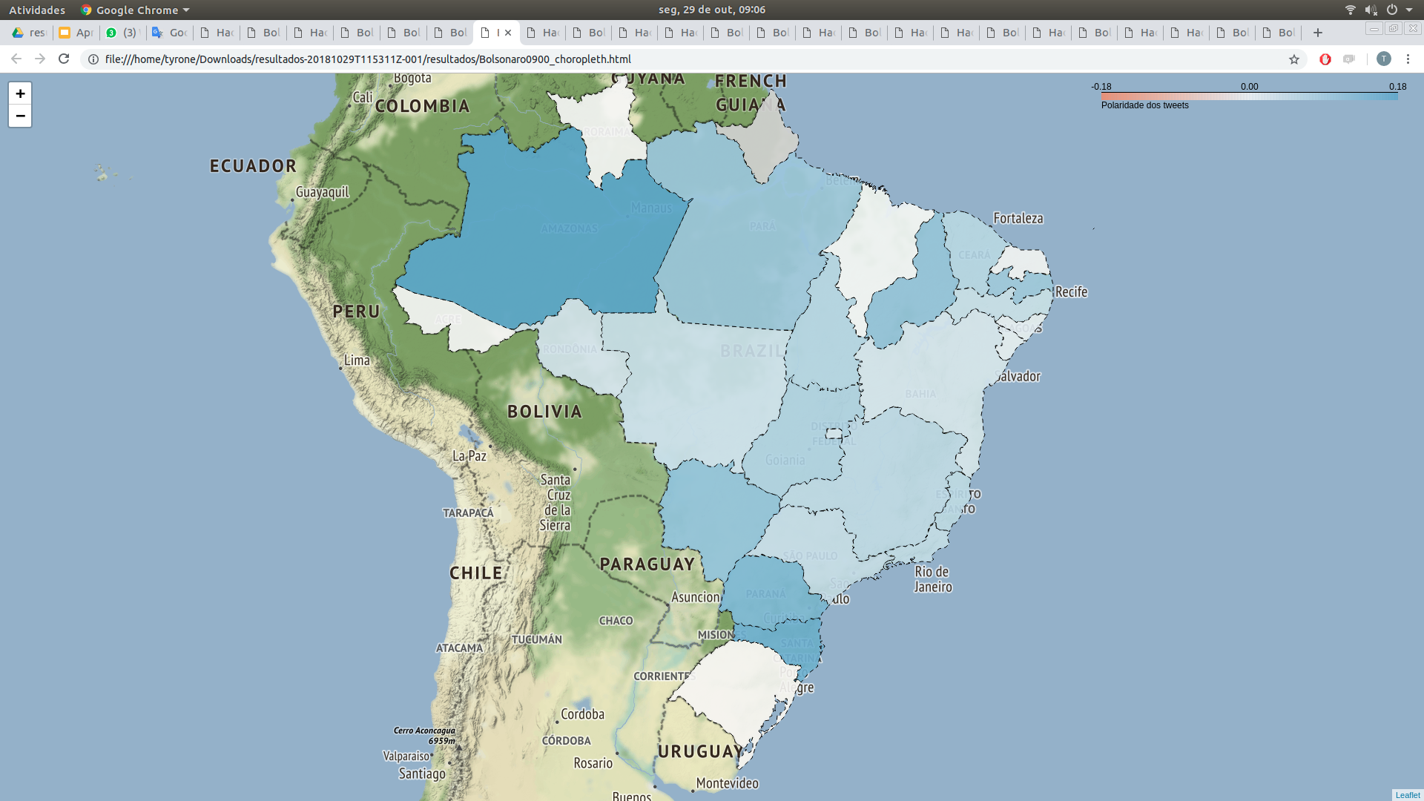
Sunday at 09:00 am
Haddad
Bolsonaro

Slide 10
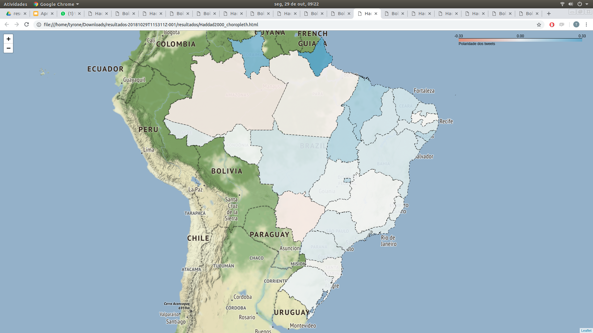
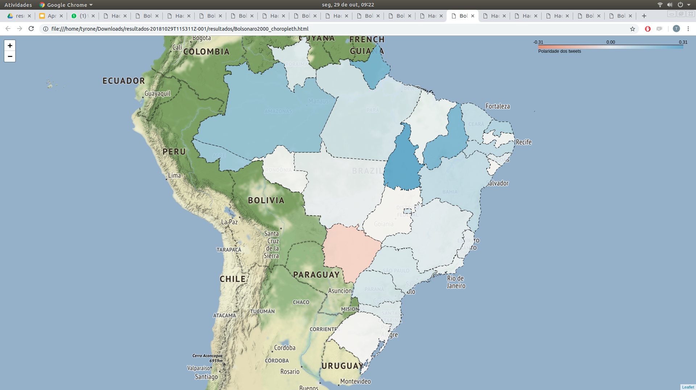
Sunday at 20:00 pm
(After the result)
Haddad
Bolsonaro

Slide 11
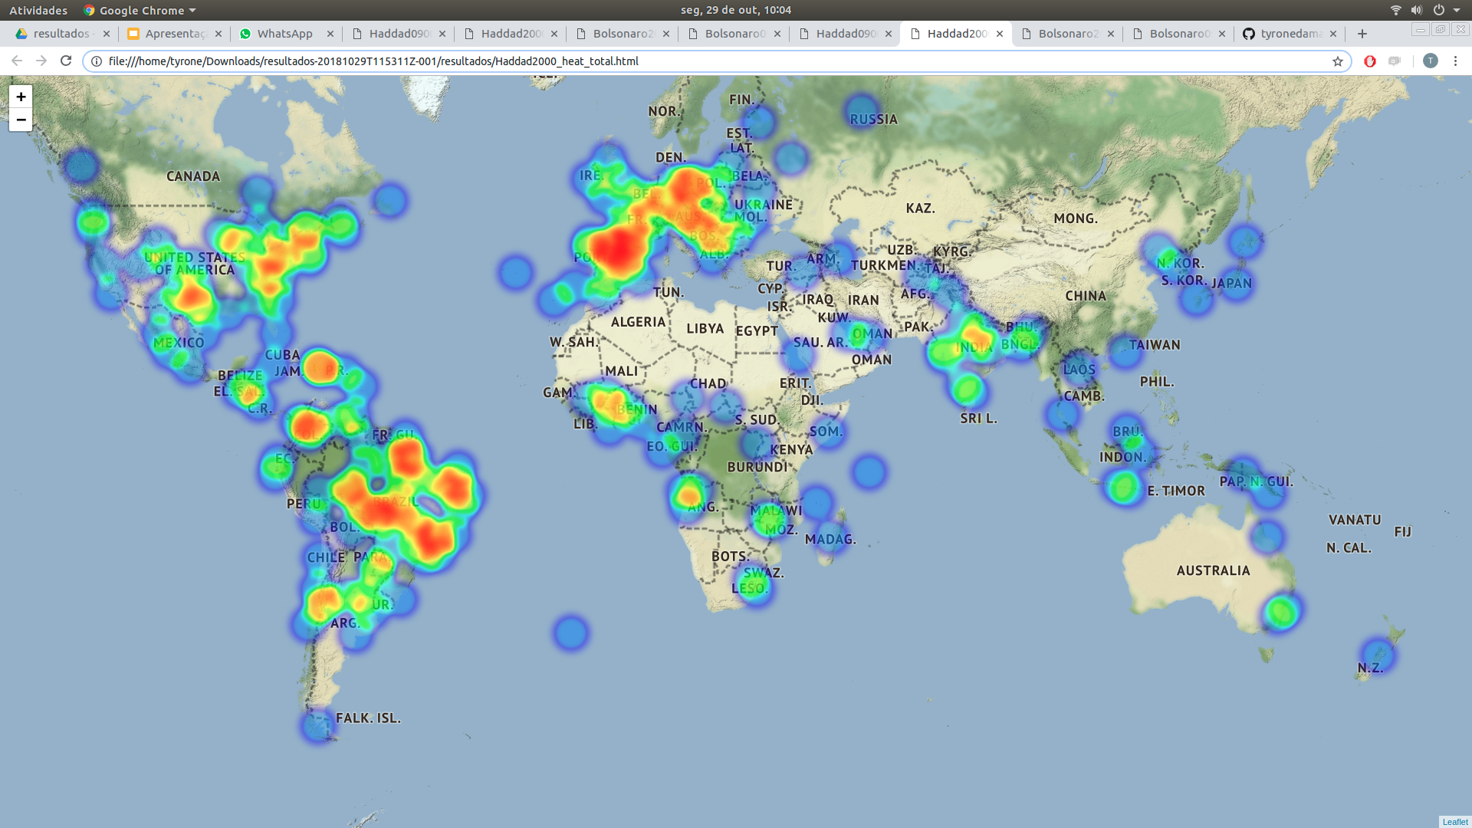
Tweets density in the world
(after the result)
Haddad

Slide 12
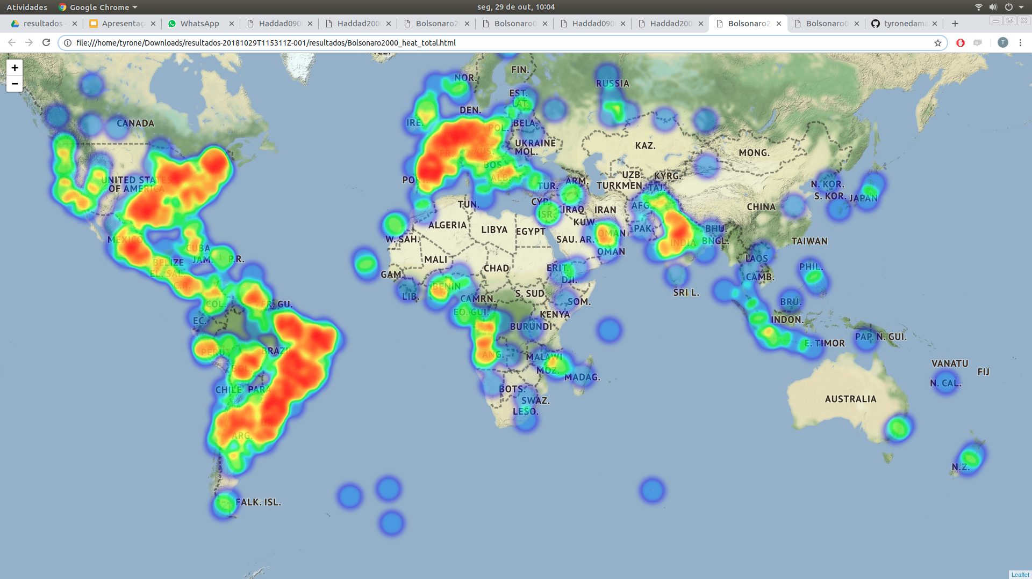
Tweets density in the world
(after the result)
Bolsonaro

Slide 13


Thanks!
Any questions?
You can find us at:
@hugoTHO
@lopespaulo
@tyronedamasceno
Repository

